Slide 1
An Introduction To Successive Sketch Model Based
Parameter Sampling Strategy
Presented by -Manisha Chetry
Supervisors: Dr. Domenico Borzacchiello
Dr. Luisa Rocha Da Silva

Slide 2
Timeline: Second year of the thesis…….

Slide 3
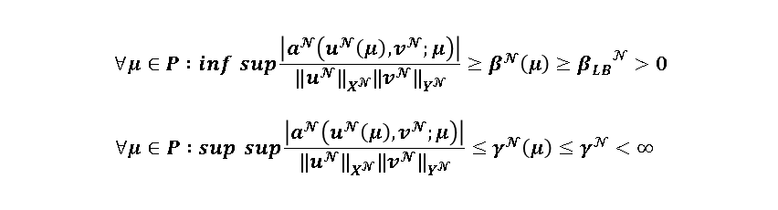
Motivation
Many PPDEs demand for a large number of input parameters and fine spatial mesh structure for better accuracy of the numerical models
To solve the fine solver at each time *huge computational cost and effort*
Develop reduced order models without the necessity of solving the high fidelity models for all the input parameters in the parametric space
Let us start considering elliptic coercive PPDEs discretized with finite elements. Denoting with $μ$ the p-vector parameter, belonging to the parameter space $P⊂ℛ^{p}$, our problem is to find $u(μ)$in an Hilbert space $X^{𝒩}$ such that
$$a^{𝒩}\left(u^{𝒩}\left(μ\right),v^{𝒩};μ\right)=f^{𝒩}\left(v^{𝒩};μ\right) ∀ v^{𝒩}∈Y^{𝒩}$$
Standard assumptions made: $a\left(.;μ\right) is coercive and continuous for all μ∈P and f\left(.;μ\right) is continuous for all μ∈P such that$
$$∀μ∈P :\inf{\sup{\frac{\left|a^{𝓝}\left(u^{𝓝}\left(μ\right),v^{𝓝};μ\right)\right|}{{{‖u}^{𝓝}‖}_{X^{𝓝}}^{}{{‖v}^{𝓝}‖}_{Y^{𝓝}}^{}}}≥β^{𝓝}\left(μ\right)}≥{β_{LB}}_{}^{𝒩}>0$$
$$∀μ∈P :\sup{\sup{\frac{\left|a^{𝓝}\left(u^{𝓝}\left(μ\right),v^{𝓝};μ\right)\right|}{{{‖u}^{𝓝}‖}_{X^{𝓝}}^{}{{‖v}^{𝓝}‖}_{Y^{𝓝}}^{}}}≤γ^{𝓝}\left(μ\right)}≤γ_{}^{𝒩}<∞$$
Reduced basis method: Reduced model of size $N<<𝒩 , where X_{N}⊂X^{𝒩} and Y_{N}⊂Y^{𝒩}$
$$a^{𝒩}\left(u_{N}\left(μ\right),v_{N};μ\right)=f^{𝒩}\left(v_{N};μ\right) ∀v_{N}∈Y_{N}$$
Classical RBM sampling driven by error estimators

Slide 4
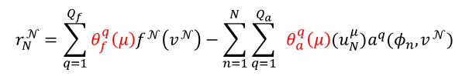
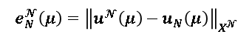
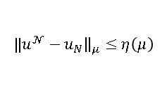
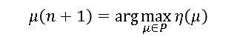
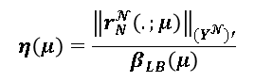
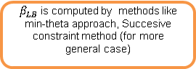
Greedy based RBM: A rigourous sharp and computationally inexpensive a posteriori error estimator is required such that :
$${‖u}^{𝒩}−u_{N}{\left.​\right\|}_{μ}≤η\left(μ\right)$$
Parameter sampling:
$$μ\left(n+1\right)=\arg{\max_{μ∈P }{η\left(μ\right)}}$$
$$e_{N}^{𝓝}\left(μ\right)={\left\|u^{𝓝}\left(μ\right)−u_{N}\left(μ\right)\right\|}_{X^{𝓝}}$$
Error estimators:
$$r_{N}^{𝓝}\left(v;μ\right)=f^{𝓝}\left(v;μ\right)−a^{𝓝}\left(u_{N}\left(μ\right),v;μ\right)=a^{𝓝}(e_{N}^{𝓝}\left(μ\right),v;μ)) ∀v∈Y^{𝓝}$$
$$η\left(μ\right)=\frac{{\left\|r_{N}^{𝓝}\left(.;μ\right)\right\|}_{{(Y}^{𝓝})′}}{β_{LB}\left(μ\right)}$$
$β_{LB}$ is computed by methods like min-theta approach, Succesive constraint method (for more general case)
$$r_{N}^{𝒩}=\sum_{q=1}^{Q_{f}}{θ_{f}^{q}\left(μ\right)f^{𝒩}\left(v^{𝒩}\right)}−\sum_{n=1}^{N}{{\sum_{q=1}^{Q_{a}}{ }θ}_{a}^{q}\left(μ\right){(u}_{N}^{μ})a^{q}(φ_{n},v^{𝒩})}$$
The complexity arrises when the operators are non affine or nonlinear in nature and computational cost increases if the number of terms increases(high dimensional parametric system)

Slide 5
Although there are research on error estimators based on non affine PPDEs.
Stable interpolation procedure for non affine or nonlinear parametric problems such as
EIM is applied for interpolation on nonlinear terms at each greedy selection
The problem we try to address here is for the problems where coercivity condition is not met and/or when error estimators are difficult to construct or are not available.
Proposing a strategy for sampling without error estimators but based on measure of error
Novel approach; Sampling based on Successive Sketch model
Initial Sketch model can be :
Fine Model or a very coarse model
Initial points can be generated randomly from the parametric sampling space

Slide 6
Objectives
Explore the parametric space iteratively based on random adaptive sampling: Motivated by the DEIM approach for finding best interpolation points using parametric modes obtained by POD.
Build the reduced basis by POD on the ensemble of snapshots at the selected finite set of points or by orthogonalisation of the snapshots by Gram Schmidt.
Numerical analysis of elliptic PDE based on 9 dimensional parametric system
Finally, to extend this sampling approach on complex problems like suspension of particles on viscoelastic medium with multi dimensional input parameters
To work on adaptive refinement of the spatial mesh of the snapshots selected based on successive sketch model strategy
Work on previous RBM greedy approach and make comparisions with SMS

Slide 7
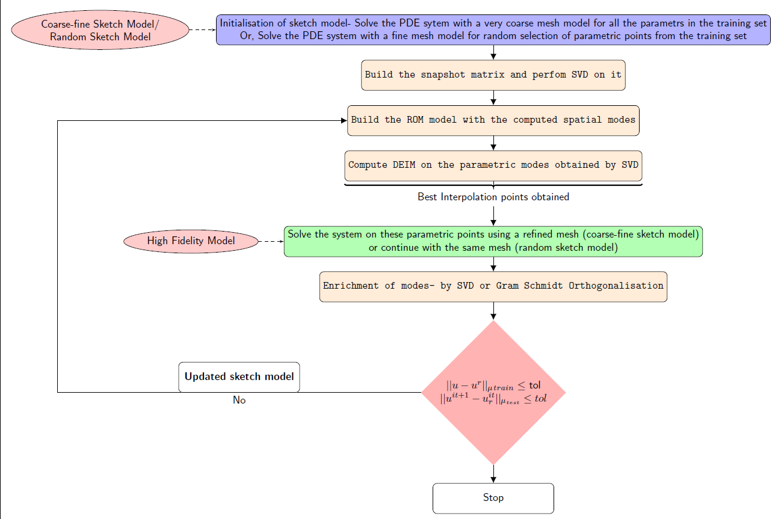
Step 1: Divide the data set into two parts
TRAINING SET
VALIDATION SET
Step 2: Follow the steps for training the data set
Step3:Error-estimation on the training set and model performance on the validation set

Slide 8
Toy Examples:
Darcy Flow problem in a 9 block
Convection Diffusion Heat Transfer in a 9 block
(Assuming, the toughest problem in our numerical test case)

Slide 9
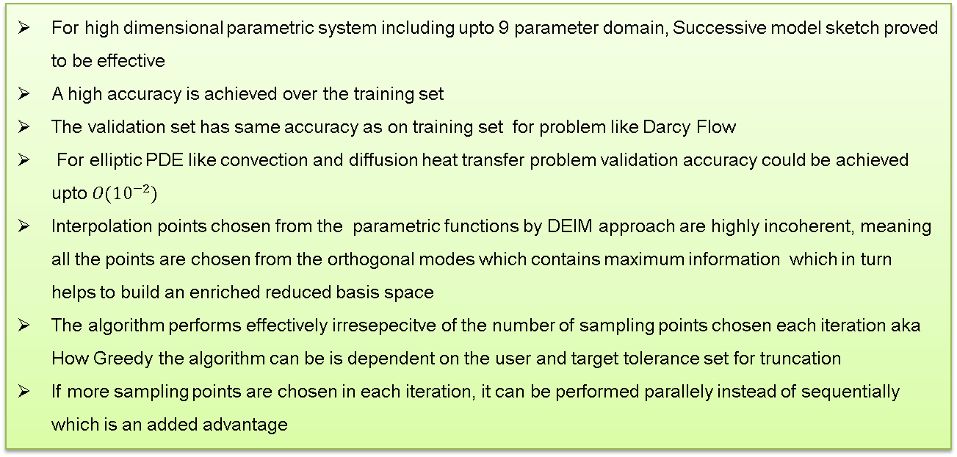
Observations
For high dimensional parametric system including upto 9 parameter domain, Successive model sketch proved to be effective
A high accuracy is achieved over the training set
The validation set has same accuracy as on training set for problem like Darcy Flow
For elliptic PDE like convection and diffusion heat transfer problem validation accuracy could be achieved upto$O({10}^{−2})$
Interpolation points chosen from the parametric functions by DEIM approach are highly incoherent, meaning all the points are chosen from the orthogonal modes which contains maximum information which in turn helps to build an enriched reduced basis space
The algorithm performs effectively irresepecitve of the number of sampling points chosen each iteration aka How Greedy the algorithm can be is dependent on the user and target tolerance set for truncation
If more sampling points are chosen in each iteration, it can be performed parallely instead of sequentially which is an added advantage

Slide 10
Perspectives
For particle suspension problems in viscoelastic medium which have orientations along three directions, so a multi dimensional parametric system can be trained using SMS algorithm for fast computations without a priori requirement of an error estimator
SMS can also be utilised for snapshots obtained with adapative mesh: Another non affine function as every snapshots will be lying in different subspaces

Slide 11
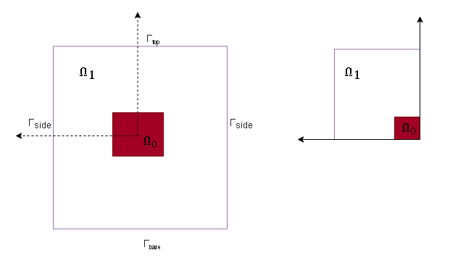
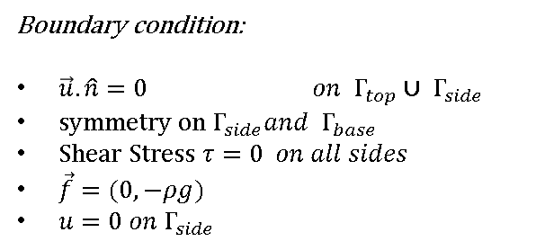
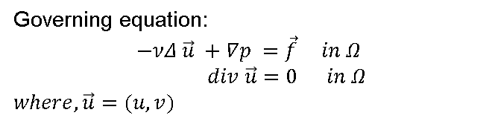
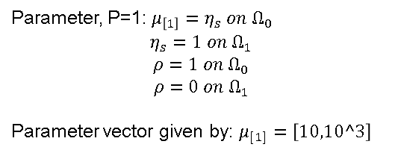
2D Sinker benchmark problem
Governing equation:
$$−νΔ \vec{u} +∇p =\vec{f} in Ω$$
$$div \vec{u}=0 in Ω$$
$$where, \vec{u}=(u,v)$$
Boundary condition:
$\vec{u}. \hat{n}=0 on Γ_{top}∪ { Γ}_{side}$
${symmetry on Γ}_{side}and { Γ}_{base}$
$Shear Stress τ=0 on all sides$
$\vec{f}=(0,−ρg)$
$u=0 on{ Γ}_{side}$
Parameter, P=1: $μ_{\left[1\right]}=η_{s} on Ω_{0}$
$$η_{s}=1 on Ω_{1}$$
$$ρ=1 on Ω_{0}$$
$$ρ=0 on Ω_{1}$$
Parameter vector given by: $μ_{[1]}=\left[10,10^3\right]$

Slide 12
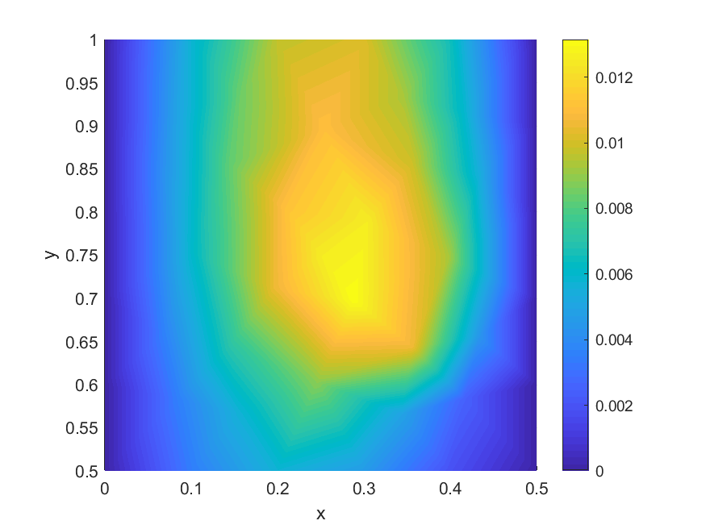
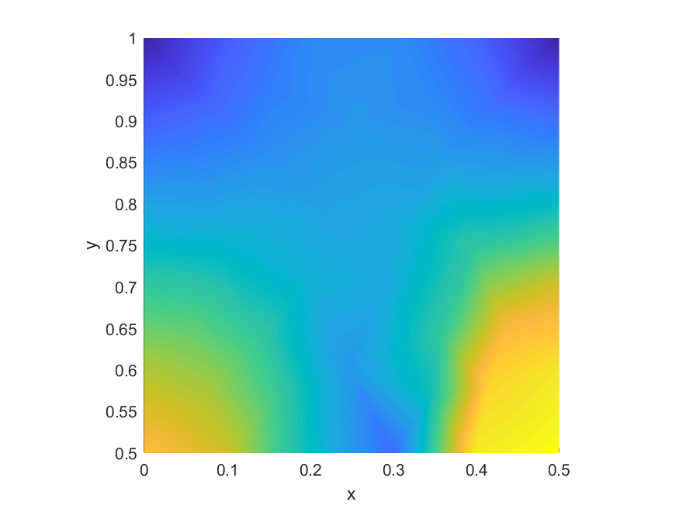
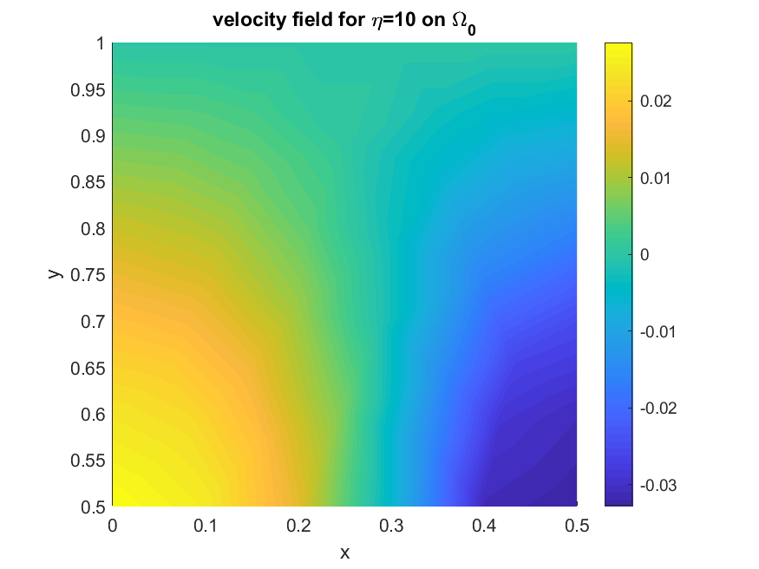
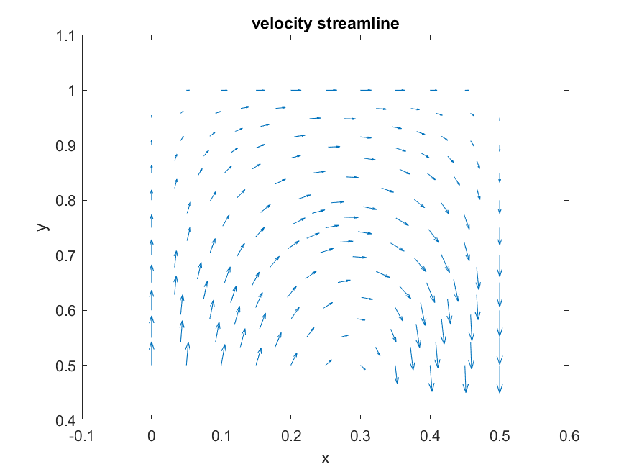
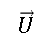
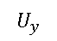
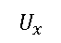
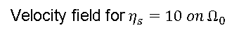
$$U_{y}$$
$$U_{x}$$
$$\vec{U}$$
Velocity field for $η_{s}=10 on Ω_{0}$

Slide 13
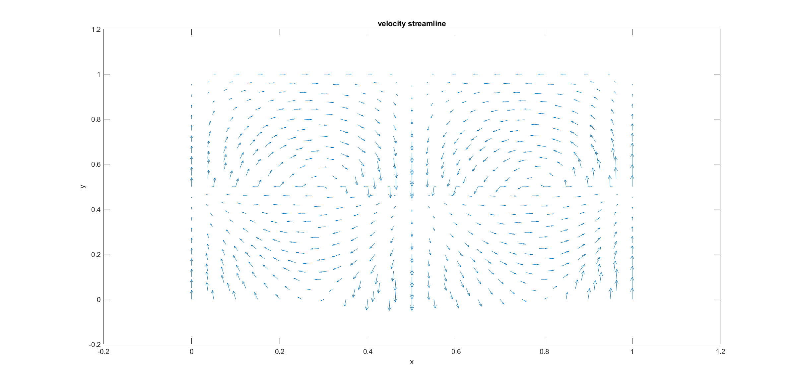

Slide 14
if you want to do particle tracing you need integrate the particle trajectory and orientation in a given flow. So each step requires the solution of afull 3D flow around the particle and possibily you need to repeat the procedure for as many particles you want to trace
How do we determine theonline procedure
Are we gonna study for the same problem or what kind of parameetr we are gonna change and study the trajectory behaviour
Future problems that can be solved:
coupling of many particles or study o many particle suspension
Coupling of multiphysics complexiyfying further the giverning equations
Changing the shape of the geometry from ellipsoid to other shapes and study the trajectory and flow behaviour
Plan of the thesis
Plan I
1st slide:To validate the framework we do a preliminary study of viscoelastic fluids , analysing two benchmark problems of viscoelastic fluids
2nd slide: Challenges in such fluid flows: How we tackle
Plan –II
Training strategy for a parametrised system:
1st Slide : Importance of training the model:
2nd slide: Challenges with previous Error estimators, only specific to certain problems. No error estimators for complex problems as such.
To give up such rigorous and deterministic error estimators very problem specific
More robust methods needed such that it can be treated as ablck box irreespective of any problem definition should be able to smple or train the model
Based on statistical error estimates/Statistical sampling

Slide 15
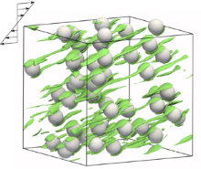
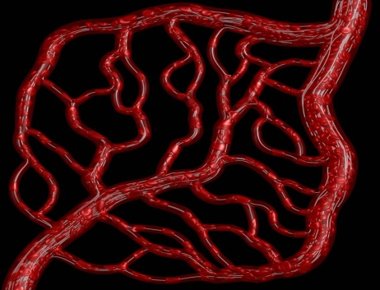
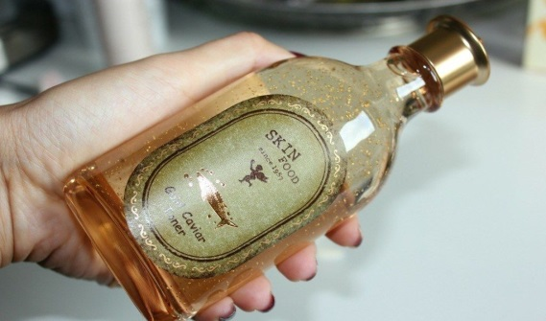
Objective/Context
Develop a framework for MOR of viscoelastic fluid flows : To model particle suspensions in Non-Newtonian fluids using 3D direct simulations of flow around rigid particles.
Shake before use always!!
Conception
Numerical Simulation
Optimisation/ Dimensionality reduction
Real time prediction of quantity

Slide 16
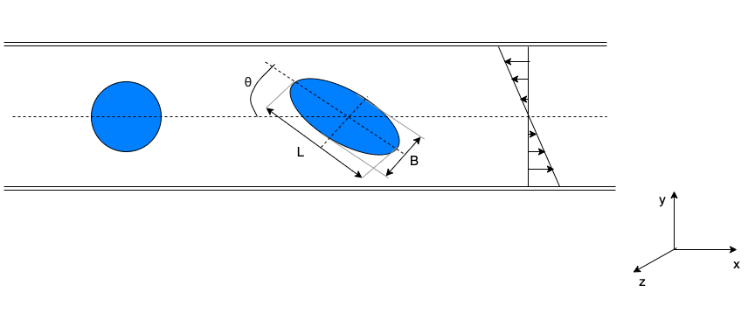
Why MOR for particle suspension problems?
Translation: 3dofs per Node
Rotation: 3dofs per Node
6 dimensional system!
N^D, Let’s say 1000 nodes in each dimension, Grid complexity: O(1000^6)
Inetgration of the particle trajectory at each step – requiring full simulation of the flow around the particle.
If there are many particles-complexity manifolds!
Goal is to reduce the computational burden of repetitive numerical simulations without simplifying the underlying physics.

Slide 17
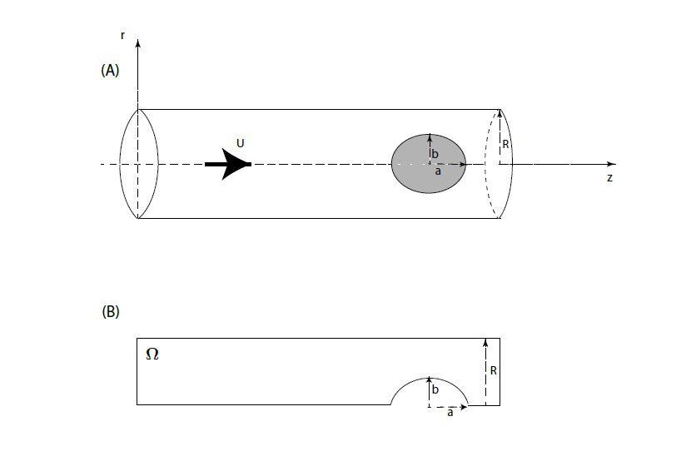
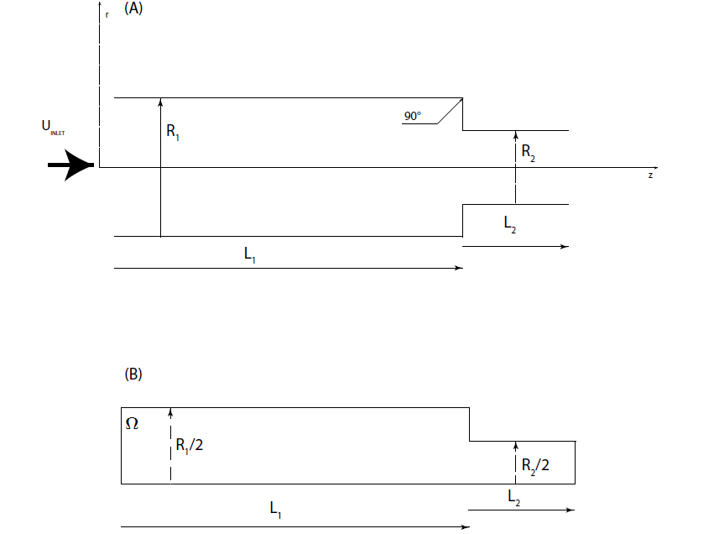
Plan -I
Validate the framework:
In order to validate the framework we started with benchmark flows like the flow past a sphere and the contraction flow
Develop a hyper-reduction framework for non-newtonian flows since it's not present in literature currently

Slide 18
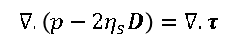
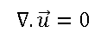
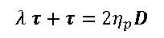
CHALLENGES
Governing Equation:
Numerical treatments like DEVSS-Galerkin and SUPG stabilisation required for stability of the numerical scheme.
DEVSS-G requires the treatment for compatibility between velocity gradient and stress stensor, so velocity grad acts as additional degrees of freedom in the problem so total DOFS : 3 (vel) + 1 (pressure) + 6 (stress) + 9 (grad V) = 19 dofs per mesh node in 3D !!! or 10 in 2D!
This makes the problem particularly challenging to solve.
Address whether similar challenges are posed in the reduced order model?
STRATEGY
Build a ROM model such that it is void of the numerical instabilities without requirement of additional treatments like in FOM and retains the same accuracy as the full order model in a very less computational time
Treat the nonlinearity and solve in a reduced computational time
$$∇. \vec{u}=0$$
Elliptic Saddle point problem
$$∇. \left(p−2η_{s}D\right)=∇. τ$$
Highly nonlinear problem
$$λ τ+τ=2η_{p}D$$
Hyperbolic in nature
Can we intrinsically remove those challenges?.

Slide 19
Plan II
Develop suitable parametrization and training strategy to have a ROM model for a particle in a viscoelastic medium
Are we really trying to solve the FOM and ROM problem for the same parameteric input? Then what is the whole point of reducing the large PDE system!!
A suitable training stategy is needed to build a ROM model.
Training the FOM from a parametric set for simulation of particle trajectory in non newtonian fluids will simplify to a greater extent!
Literatures present for error estimators already
But they are very problem specific and also no error estimators developed currently to tackle a complex problem as viscoelastic fluid flows!
STRATEGY:
To build a robust methodology such that it can be be treated as black box irrespective of any problem definition should be able to sample or train the model
Based on statistical error estimates rather than building error estimators

Slide 20
Methodologie
Offline Task
Generation of snapshots by solving high fidelity system
Computation of basis
Linear/Affine system-POD/SVD or Reduced basis by greedy selection
Online Task
Solve the ROM
Non linear or non affine system-EIM/DEIM and Hyper reduction

Slide 21
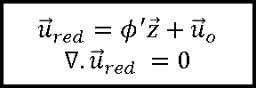
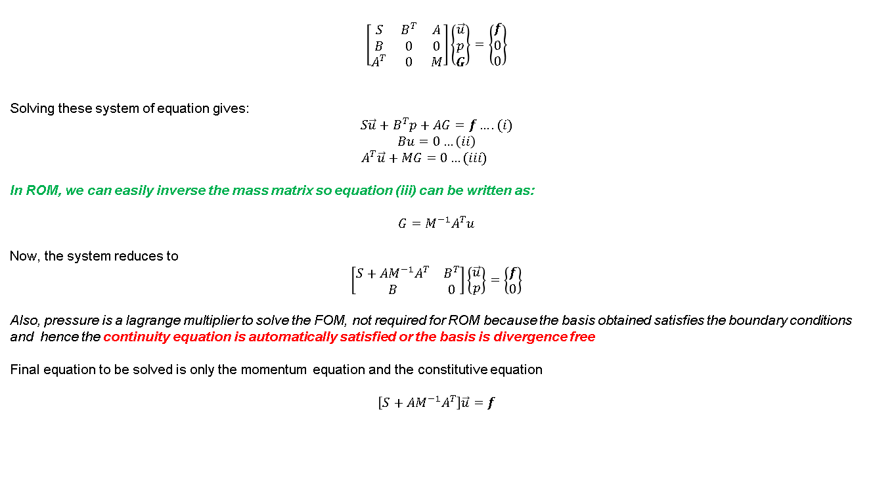
$$\left[\begin{matrix}S & B^{T} & A \\ B & 0 & 0 \\ A^{T} & 0 & M\end{matrix}\right]\left\{\begin{matrix}\vec{u} \\ p \\ G\end{matrix}\right\}=\left\{\begin{matrix}f \\ 0 \\ 0\end{matrix}\right\}$$
Solving these system of equation gives:
$$S\vec{u}+B^{T}p+AG=f….(i)$$
$$Bu=0…\left(ii\right)$$
$A^{T}\vec{u}+MG=0…(iii)$
In ROM, we can easily inverse the mass matrix so equation (iii) can be written as:
$$G=M^{−1}A^{T}u$$
Now, the system reduces to
$$\left[\begin{matrix}S+AM^{−1}A^{T} & B^{T} \\ B & 0\end{matrix}\right]\left\{\begin{matrix}\vec{u} \\ p\end{matrix}\right\}=\left\{\begin{matrix}f \\ 0\end{matrix}\right\}$$
Also, pressure is a lagrange multiplier to solve the FOM, not required for ROM because the basis obtained satisfies the boundary conditions and hence the continuity equation is automatically satisfied or the basis is divergence free
Final equation to be solved is only the momentum equation and the constitutive equation
$$\left[S+AM^{−1}A^{T}\right]\vec{u}=f$$
Extra auxiliary variable-velocity gradient comes from DEVSS-G stabilisation
Basis construction
${\vec{u}}_{red}=φ^{′}\vec{z}+{\vec{u}}_{o}$
$$∇. {\vec{u}}_{red} =0$$

Slide 22
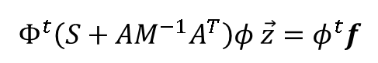
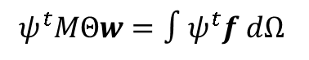
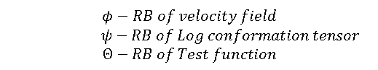
Reduced order Model
Momentum Eq:
$$Φ^{t}\left(S+AM^{−1}A^{T}\right)φ \vec{z}=φ^{t}f$$
$$φ−RB of velocity field$$
$ψ−RB of Log conformation tensor$
$$Θ−RB of Test function$$
Precomputed!
Constitutive Eq:
SUPG Online
The same stabilization scheme as the FOM method is applied
Petrov Galerkin
Apply PG but contrarily to the SUPG online the residual of the constitutive equation is projected onto a fixed basis that is computed once and for all from in the offline step
Galerkin
Equivalent of applying no stabilization at all. Heurisitic idea: the reduced space is constructed from stabilized snapshots and therefore should not include unstable modes
$$ψ^{t}MΘw=∫ψ^{t}f dΩ$$
Precomputed or Non precomputed!

Slide 23
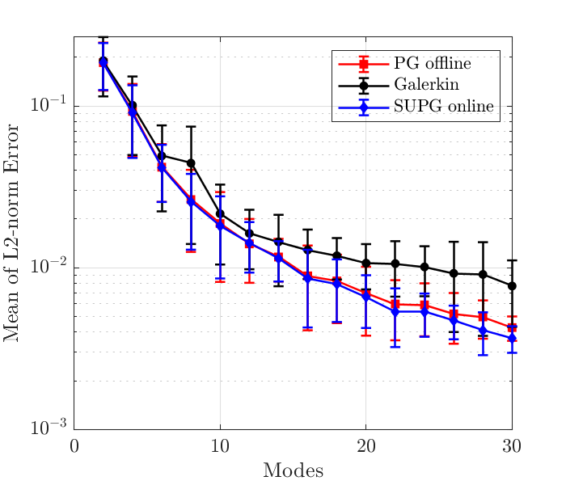
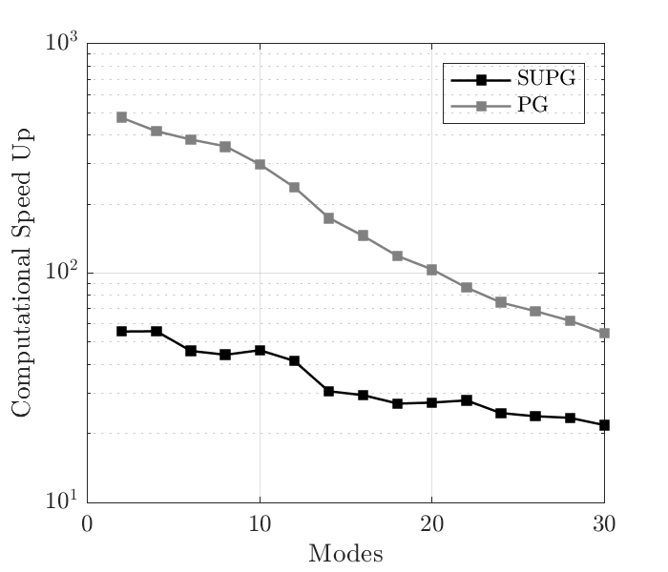
Numerical Analysis
Fig: (L)L2 norm error between FOM and ROM solution. (R)Computational speed up using offline and online stabilisation
Offline stabilization leads to results that are comparable to those of online stabilization with considerably lower computational effort.
But the results can be further improved by applying hyper-reduction of the nonlinear term

Slide 24
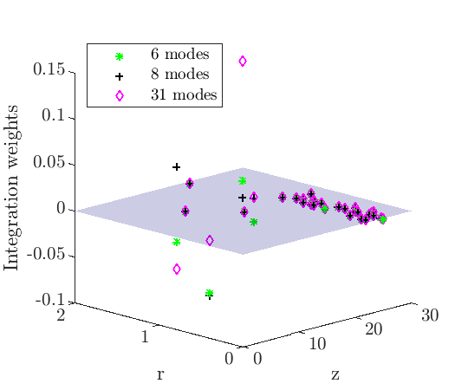
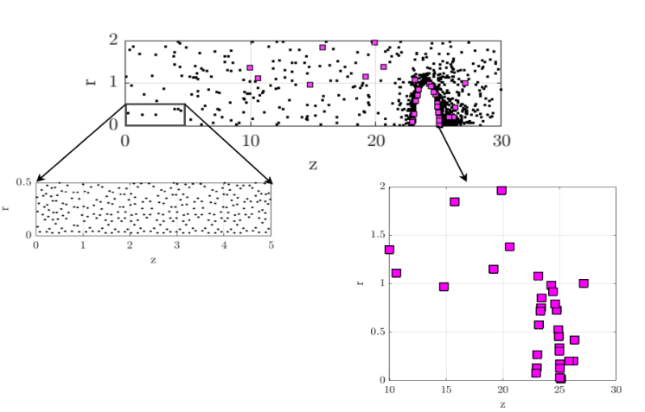
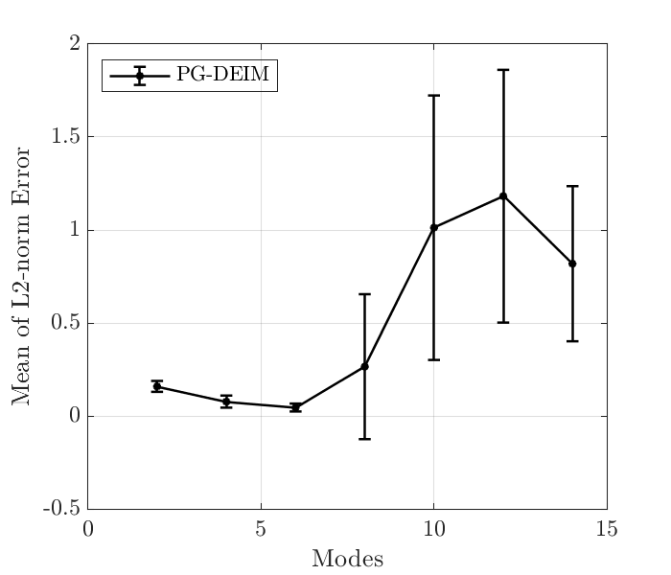
DEIM Points
Weights of EIM points
DEIM unable to preserve the stability properties of the original numerical scheme used for the FOM

Slide 25
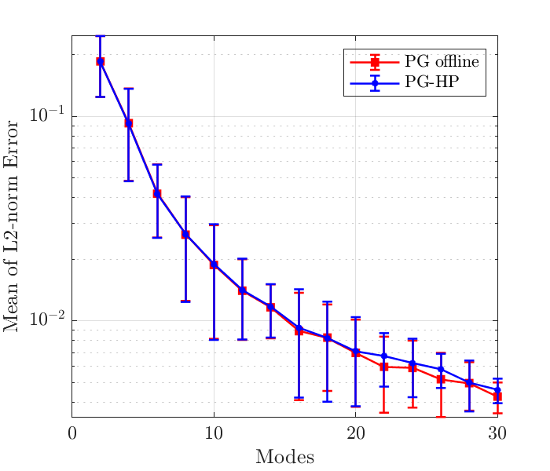
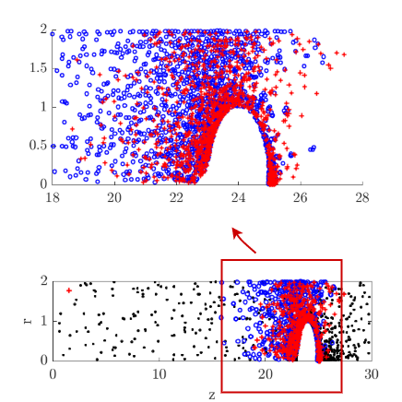
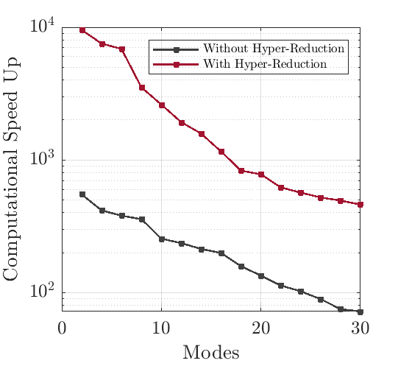
Integration points using Hyper reduction
Reduction of Integration points from 106506 to 1003 for the rhs of the constitutive equation and to 1459 quadrature points for the momentum equation!!

Slide 26
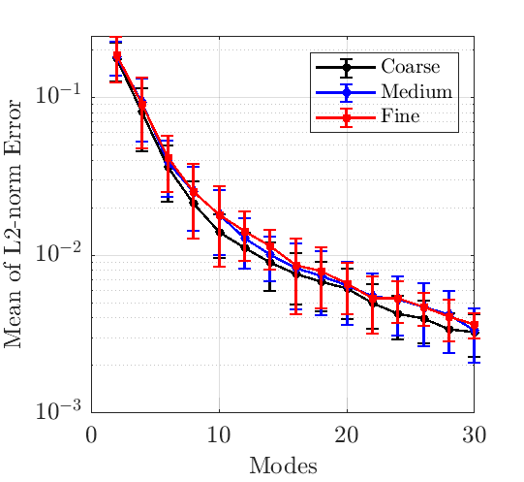
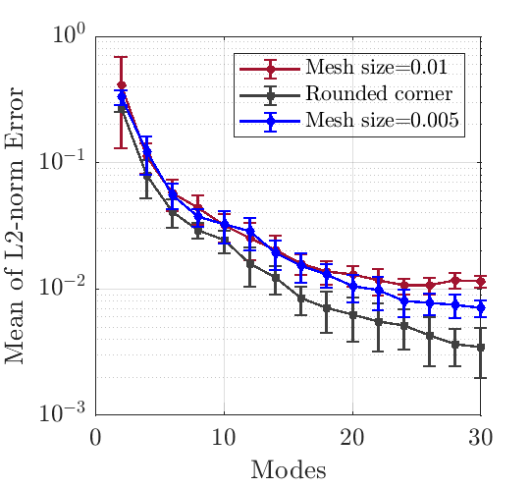
Mesh dependency on the convergence
(L) Relative error of flow past a sphere problem between FOM and ROM solutions and (R) Relative error of contraction flow problem

Slide 27
CONCLUSION
The algebraic problem is greatly simplified in the ROM formulation since
By construction of the reduced basis, incompressibility constraint is automatically satisfied, removes the pressure dofs
Momentum equation does not need DEVSS stabilization anymore removes the velocity gradient dofs
Stabilization of the advection term in the constitutive equation can be simplified through an offline stabilization procedure.
Particular attention must be paid to the treatment of the nonlinear term as it may lead to instability of the reduced order scheme (ensuring the positivity of the reduced quadrature rule is crucial)
Mesh dependency requires further investigation.
The framework that we set up produced (10e4)X speed up for a simple 2D problem. Even higher speedups are reasonably expected for the 3D case (work in progress)

Slide 28
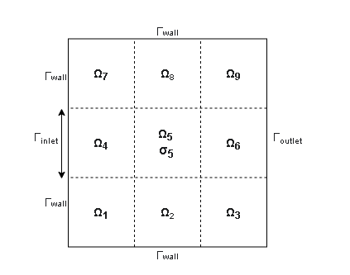
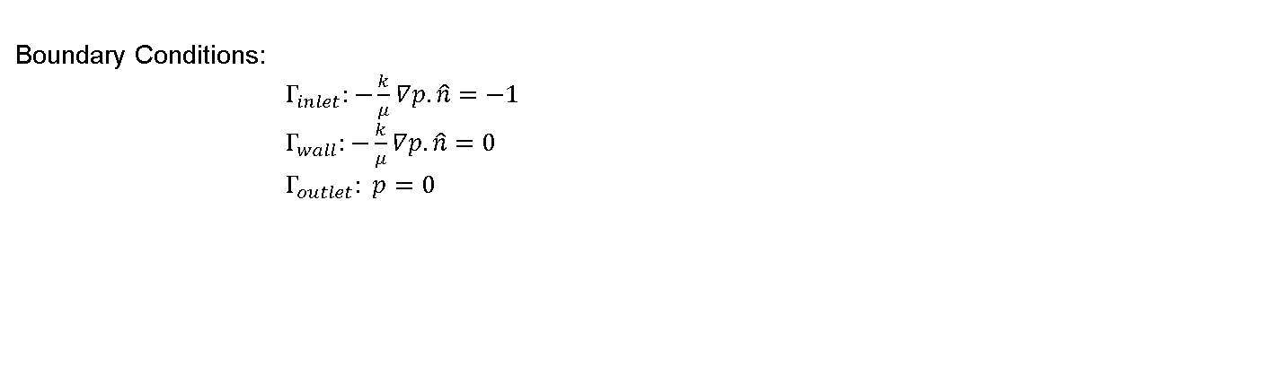
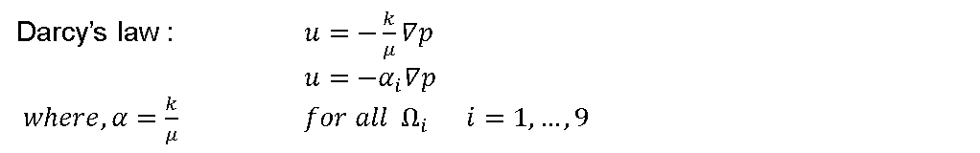
Darcy’s law : $u=−\frac{k}{μ}∇p$
$u=−α_{i}∇p$
$where, α=\frac{k}{μ}$ ${for all Ω}_{i} i=1,…,9$
Boundary Conditions:
$Γ_{inlet}:−\frac{k}{μ}∇p.\hat{n}=−1$
$Γ_{wall}:−\frac{k}{μ}∇p.\hat{n}=0$
$Γ_{outlet}: p=0$

Slide 29
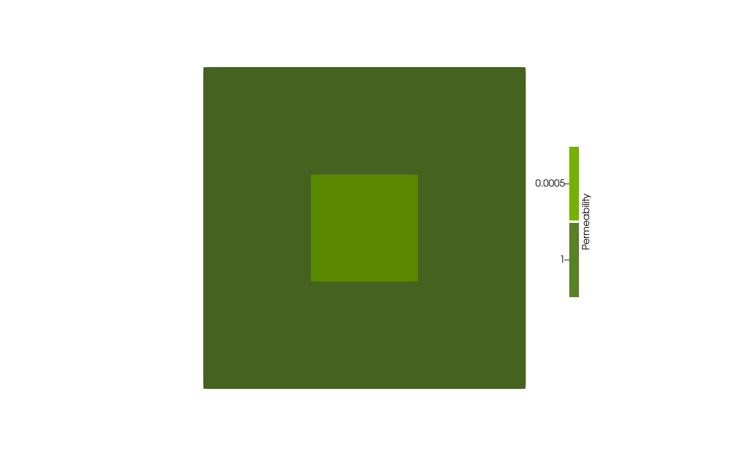





Visualisations of the solution field based on different combination of parameters

Slide 30

Lattice Hyper Cube Sampling of the parametric space for permeability , $k ∈$ [10^-5 , 1]
lying in 9 dimensions

Slide 31





Based on Coarse-Fine Model
Convergence order $Ο\left({10}^{−8}\right)$
Increment of points=30

Slide 32



Convection –Diffusion Heat Source Problem
Governing equations: $\vec{a}.∇u−k∆u+σ=0$
$\vec{a}.∇u−k_{i}∆u+σ=0$ ${for all Ω}_{i} i=1,…,9$
Boundary Conditions:
Dirichlet BC: $Γ_{inlet}:u=0$
$Γ_{outlet}:u=0$
Heat Source term on $Ω_{5}: σ=1$
Apply SUPG stabilisation for stabilising the convection term for higher Peclet number

Slide 33








Numerical results for Temperture for varying conductivities
$$k=0,01$$
$$k=0,1$$
$$k=5$$
$$k=10$$

Slide 34

Lattice Hyper Cube Sampling of the parametric space for conductivity, $k ∈$ [0.01 , 10]
lying in 9 dimensions

Slide 35





Initial Random points=100
Increment of points each iteration =10
13 iterations, Total points added= 220
Convergence $Ο\left({10}^{−8}\right)$

Slide 36





Initial Random points=10
Incremental points= 10
22 iterations, Total points added= 220
Convergence $Ο\left({10}^{−8}\right)$

Slide 37
SMS
Initial Sketch Model =Coarse Full order Model
Updated Sketch Model = Fine Reduced Order Model

Slide 38




Increment of points each iteration =100
6 iterations, total of 600 points

Slide 39




Incremental points each iteration =10
38 iterations, 380 points
Convergence $Ο\left({10}^{−4}\right)$

Slide 40



Mesh dependency on the PDE problem
(L) Fine mesh (R) Coarse mesh
24 iterations needed to acheive the set target , convergence is of the order $𝒪({10}^{−8})$for the coarse mesh
30 iterations needed to acheive the set target , convergence is of the order $𝒪({10}^{−4})$for the finer mesh

Slide 41


Offline-online (SUPG stabilisation)
Offline stabilisation - online no stabilisation (heurisitic idea: underlying basis are stable from the offline computations)
(L) Fine Mesh- SUPG stabilised offline-online
(c) Coarse mesh –offline stabilised
(R) Fine mesh- offline stabilised

Slide 42
Classical RBM-Greedy Approach

Slide 43









Strong form of the heat conduction equation for some parameter value $μ∈ P$, find $u\left(μ\right)$ such that:
$$−{∇. κ}_{μ}∇u\left(μ\right)=0 in Ω∈[0,1]×[0,1]$$
$$u\left(μ\right)=0 on Γ_{top}$$
$κ_{μ}∇u\left(μ\right).\hat{n} =0 on { Γ}_{side}$
$$κ_{μ}∇u\left(μ\right).\hat{n} =μ_{\left[2\right]} on { Γ}_{base}$$
${\text{Г}}_{top}$
$$Ω_{1}$$
$$Ω_{0}$$
Parameter, P=2:
$μ_{\left[1\right]}=κ_{0}$ and $μ_{\left[2\right]}=constant heat flux over Γ_{base}$
Parameter vector given by: $\left(μ_{\left[1\right]},μ_{\left[2\right]}\right)=\left[0.1,10\right]×[−1,1]$
${\text{Г}}_{side}$
${\text{Г}}_{side}$
$$κ=κ_{0}$$
$$κ=1$$
${\text{Г}}_{base}$

Slide 44






$$μ_{\left[1\right]}=0,1,μ_{\left[2\right]}=−1$$
$$μ_{\left[1\right]}=0.4, μ_{\left[2\right]}=0,5$$
L:SMS, C: Greedy and R: Sampling points

Slide 45




Slide 46


Error for coarse mesh
9 block transport equation
10 it, 100 it respectively

Slide 47
Plan-II
Objective: Develop a suitable training strategy in the parametric space to build a ROM model for a particle in a viscoleastic medium
Training strategy for a parametrised system:
1st Slide : Importance of training the model:

Slide 48
Challenges
Good amount of literature on the error estimators but very problem specific
If the problem is high dimensional system like
Challenges with previous Error estimators, only specific to certain problems. No error estimators for complex problems as such.
To give up such rigorous and deterministic error estimators very problem specific
More robust methods needed such that it can be treated as ablck box irreespective of any problem definition should be able to smple or train the model
Based on statistical error estimates/Statistical sampling

Slide 49
Timeline: First year of the thesis

Slide 50

« State of the art »
Reduced Order modelling for complex viscoelastic fluids:
Challenges addressed:
Momentum and constitutive equations are stabilised on reduced order models without additional set of equations like DEVSS-G for momentum equation and without SUPG for constitutive equation as solved in FOM
Reduction of Nonlinear terms at a computational cost which is $Ο\left(10^4\right)$ times faster than the FOM or $Ο\left({10}^{3}\right)$ faster than ROM without reduction of nonlinear terms
Reduction of linear terms: POD/RBM
Reduction of nonlinear terms: EIM/DEIM (Interpolation Approach)
Hyper Reduction(Integration based approach): Finding sparse representation of the over determined system

Slide 51
Complex Fluid Flow Problem: Viscoelastic Fluids
2 benchmark problems:
Flow past a Sphere
4:1 Contraction Flow Problem

Slide 52


System of equations for the Viscoelastic flow model
$$\left[\begin{matrix}S & B^{T} & A \\ B & 0 & 0 \\ A^{T} & 0 & M\end{matrix}\right]\left\{\begin{matrix}\vec{u} \\ p \\ G\end{matrix}\right\}=\left\{\begin{matrix}f \\ 0 \\ 0\end{matrix}\right\}$$
$$\left[\begin{matrix}S & B^{T} & A \\ B & 0 & 0 \\ A^{T} & 0 & M\end{matrix}\right]\left\{\begin{matrix}\vec{u} \\ p \\ G\end{matrix}\right\}=\left\{\begin{matrix}f \\ 0 \\ 0\end{matrix}\right\}$$
Solving the linear system of equation gives:
$$S\vec{u}+B^{T}p+AG=f….(i)$$
$$Bu=0…\left(ii\right)$$
$A^{T}\vec{u}+MG=0$ …..(iii)
In ROM, we can easily inverse the mass matrix so equation (iii) becomes
$$G=M^{−1}A^{T}u$$
So the system reduces to
$$\left[\begin{matrix}S+AM^{−1}A^{T} & B^{T} \\ B & 0\end{matrix}\right]\left\{\begin{matrix}\vec{u} \\ p\end{matrix}\right\}=\left\{\begin{matrix}f \\ 0\end{matrix}\right\}$$
Also, pressure is a lagrange multiplier to solve the FOM, not required for ROM because the basis obtained satisfies the boundary conditions and hence the continuity equation is automatically satisfied or the basis is divergence free
Final equation to be solved is only the momentum equation and the constitutive equation
$$\left[S+AM^{−1}A^{T}\right]\vec{u}=f$$

Slide 53

Modelling of constitutive equation
Three different test functions implemented for building reduced order model for contitutive equation
SUPG (based on the basis function of the solution field and stabilise online)
PG (based on the snapshots of the SUPG stabilisation of the FOM computed offline)
Galerkin
($\underbrace{d+γ\vec{u}.∇d},\frac{∂s}{∂t}+\vec{u}.∇s−G(L,s))=0$
Test function

Slide 54




Slide 55

Diffusion reaction problem with adaptive mesh using ICITech Solver
$$∆u+λu=\left(λ+1\right)f$$

